Slide 1
E-Quiz App
A Flutter based android app

Slide 2
Introduction
The project is based on flutter and the dart programming language. It is an android application which allows and helps students to take quiz on various topics. This is app is targeted to the school and college students who wants to test their knowledge on a particular subject.
This app includes various features like quiz list, taking quiz, showing the result of the quiz in a fun manner.
This app is user friendly and very simple to use. The clean UI helps the user to concentrate on the quiz and taking the quiz seriously.

Slide 3
Objective & Motivation
The objective is to design and develop an android app which helps student to track their daily quiz score.
The motivation behind this app is to design and develop a solution which helps students to check their subject skills. With the help of this app we tend to help students take record of their quiz scores which in return will help them to improve their knowledge. In this time, it is very important to increase skills and knowledge in various fields for good placements. Many students fail to maintain the record of their score on paper or in their mind and cannot practice and learn according to their knowledge. This app indirectly helps all weak and intelligent students to test their skills and knowledge and making command on particular subjects.This app also motivates students to work hard.

Slide 4
Technologies Used
Flutter
Flutter is an open-source UI software development kit created by Google. It is used to develop applications for Android, iOS, Linux, Mac, Windows, Google Fuchsia, and the web from a single codebase.
Flutter offers outstanding performance for two reasons. First, is uses Dart, which compiles into native code. Second, Flutter has its own widgets, so there’s no need to access OEM ones
Dart Programming Language
Dart is a client-optimized programming language for apps on multiple platforms. It is developed by Google and is used to build mobile, desktop, server, and web applications.
Dart is an object-oriented, class-based, garbage-collected language with C-style syntax. Dart can compile to either native code or JavaScript.

Slide 5
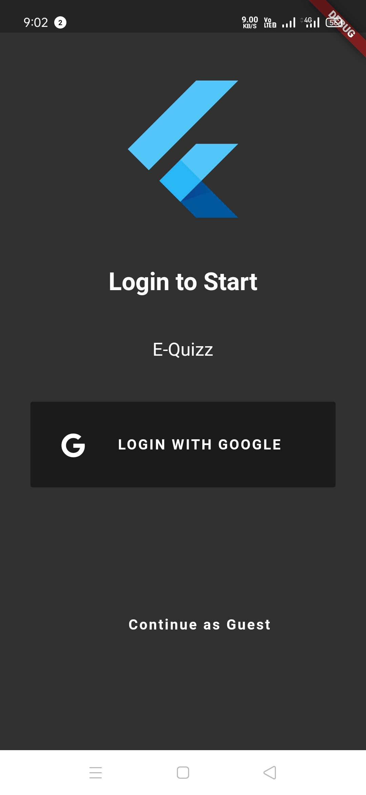
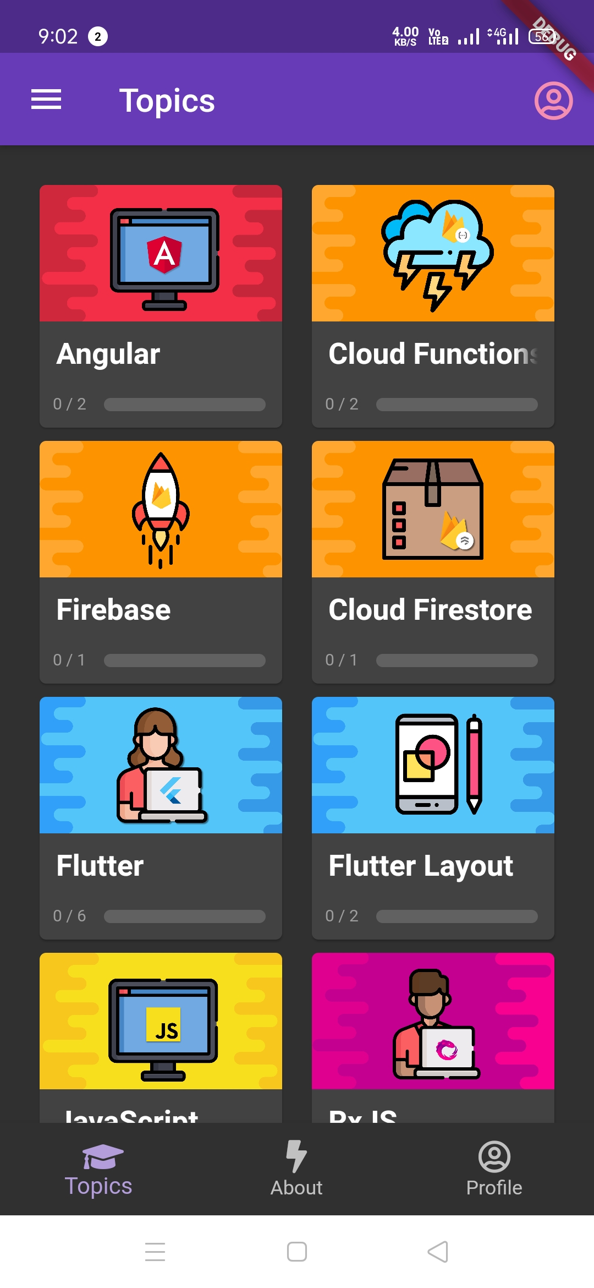
User Interface
The User Interface (UI) consists of 4 main things
Login
Quizzes on Various topic
Starting the quiz
Quiz Completion

Slide 6
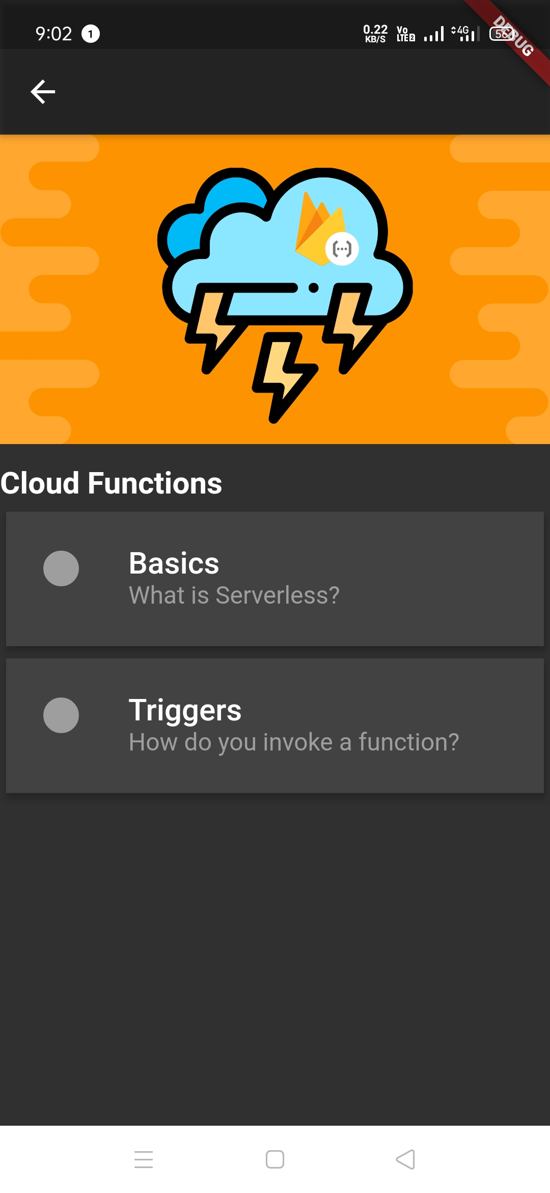
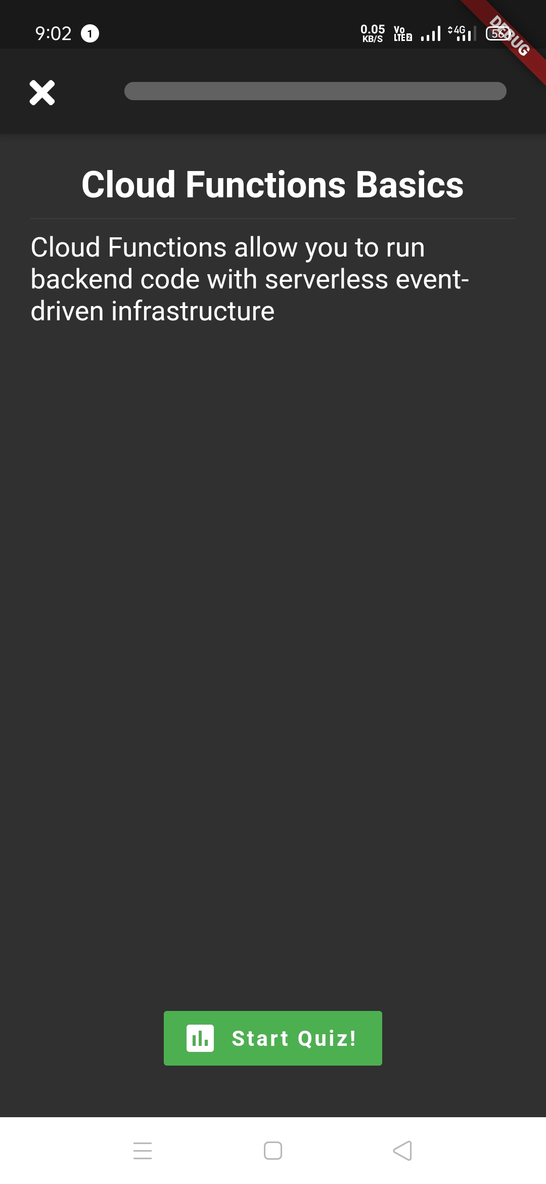
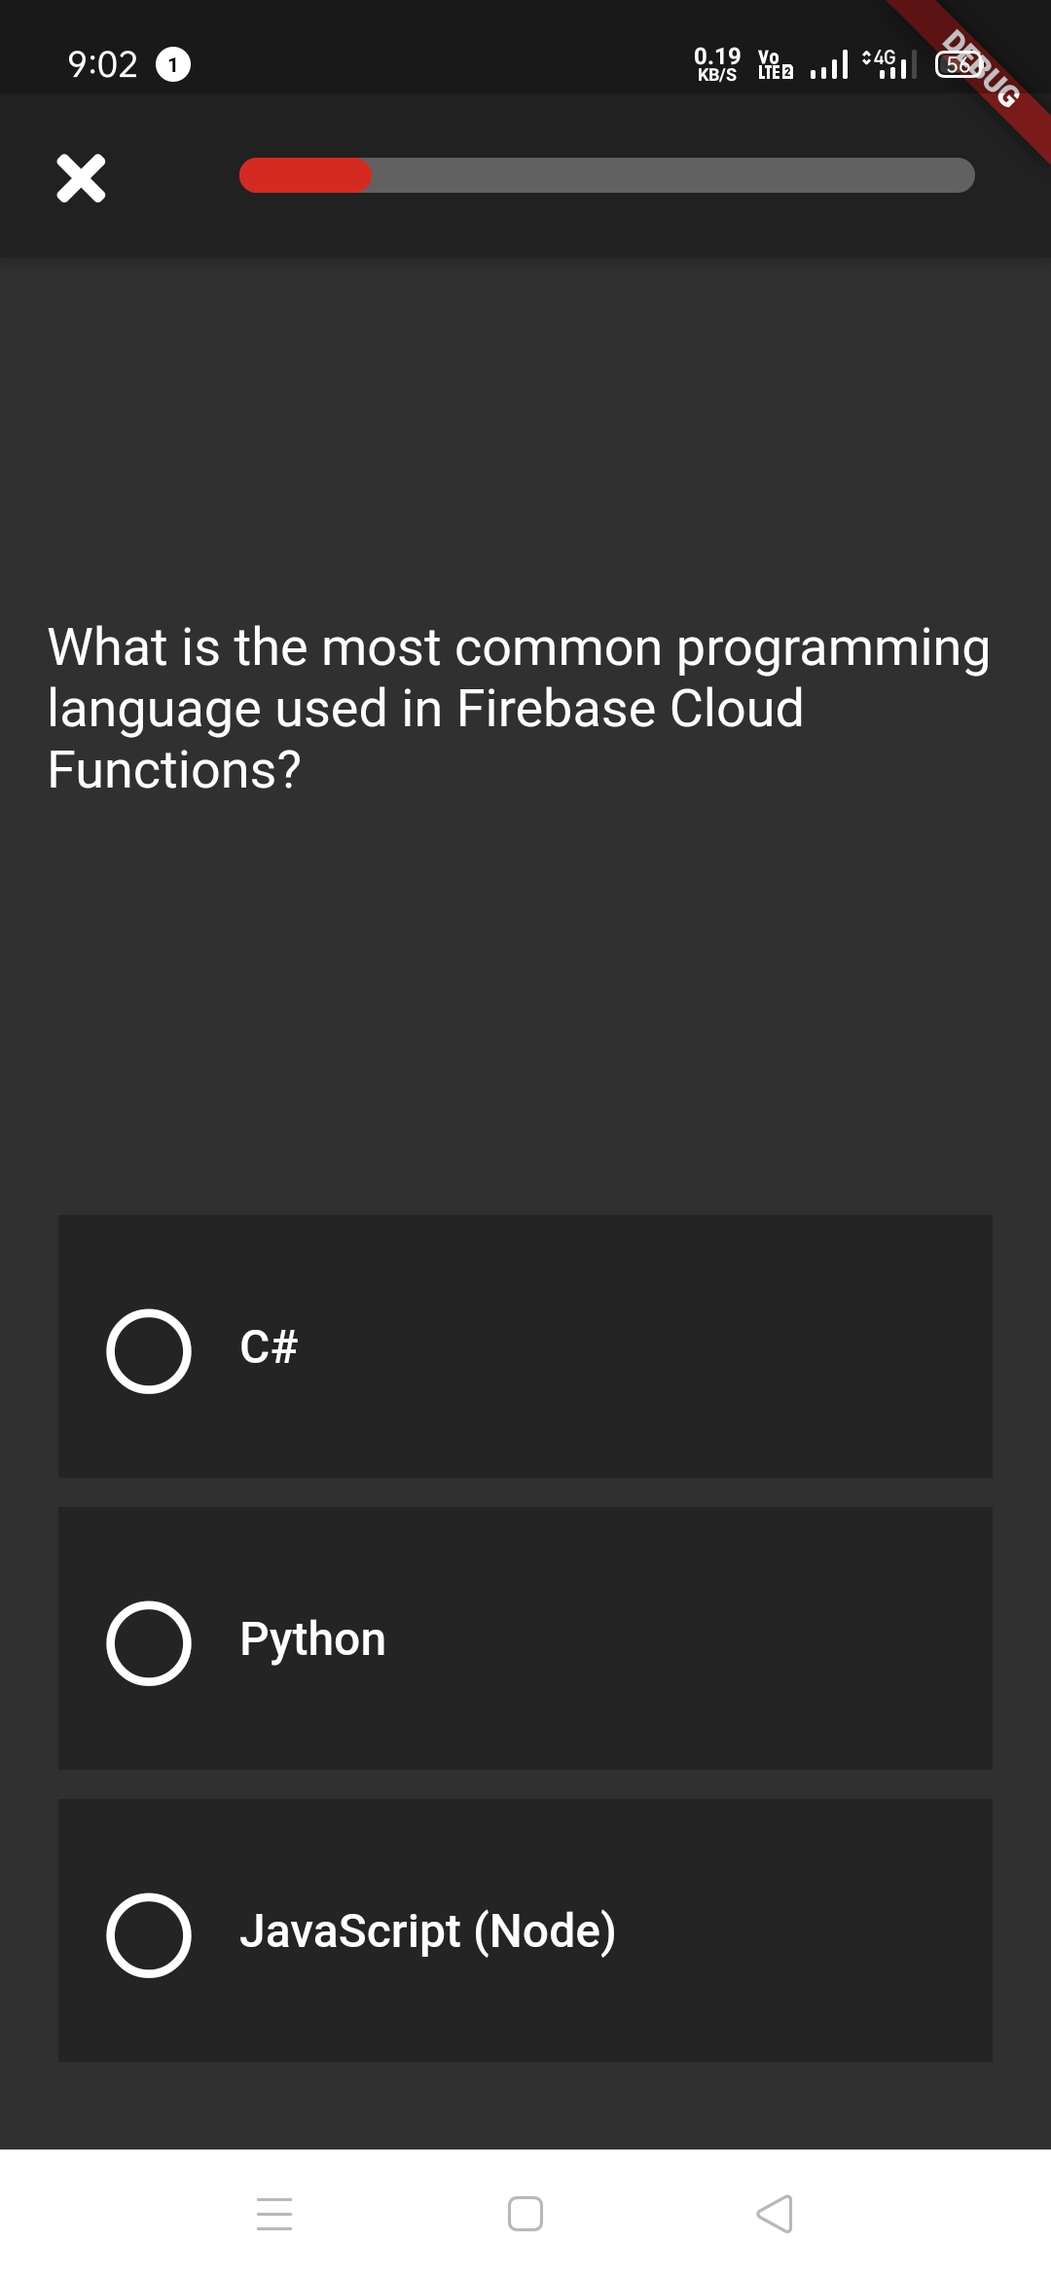
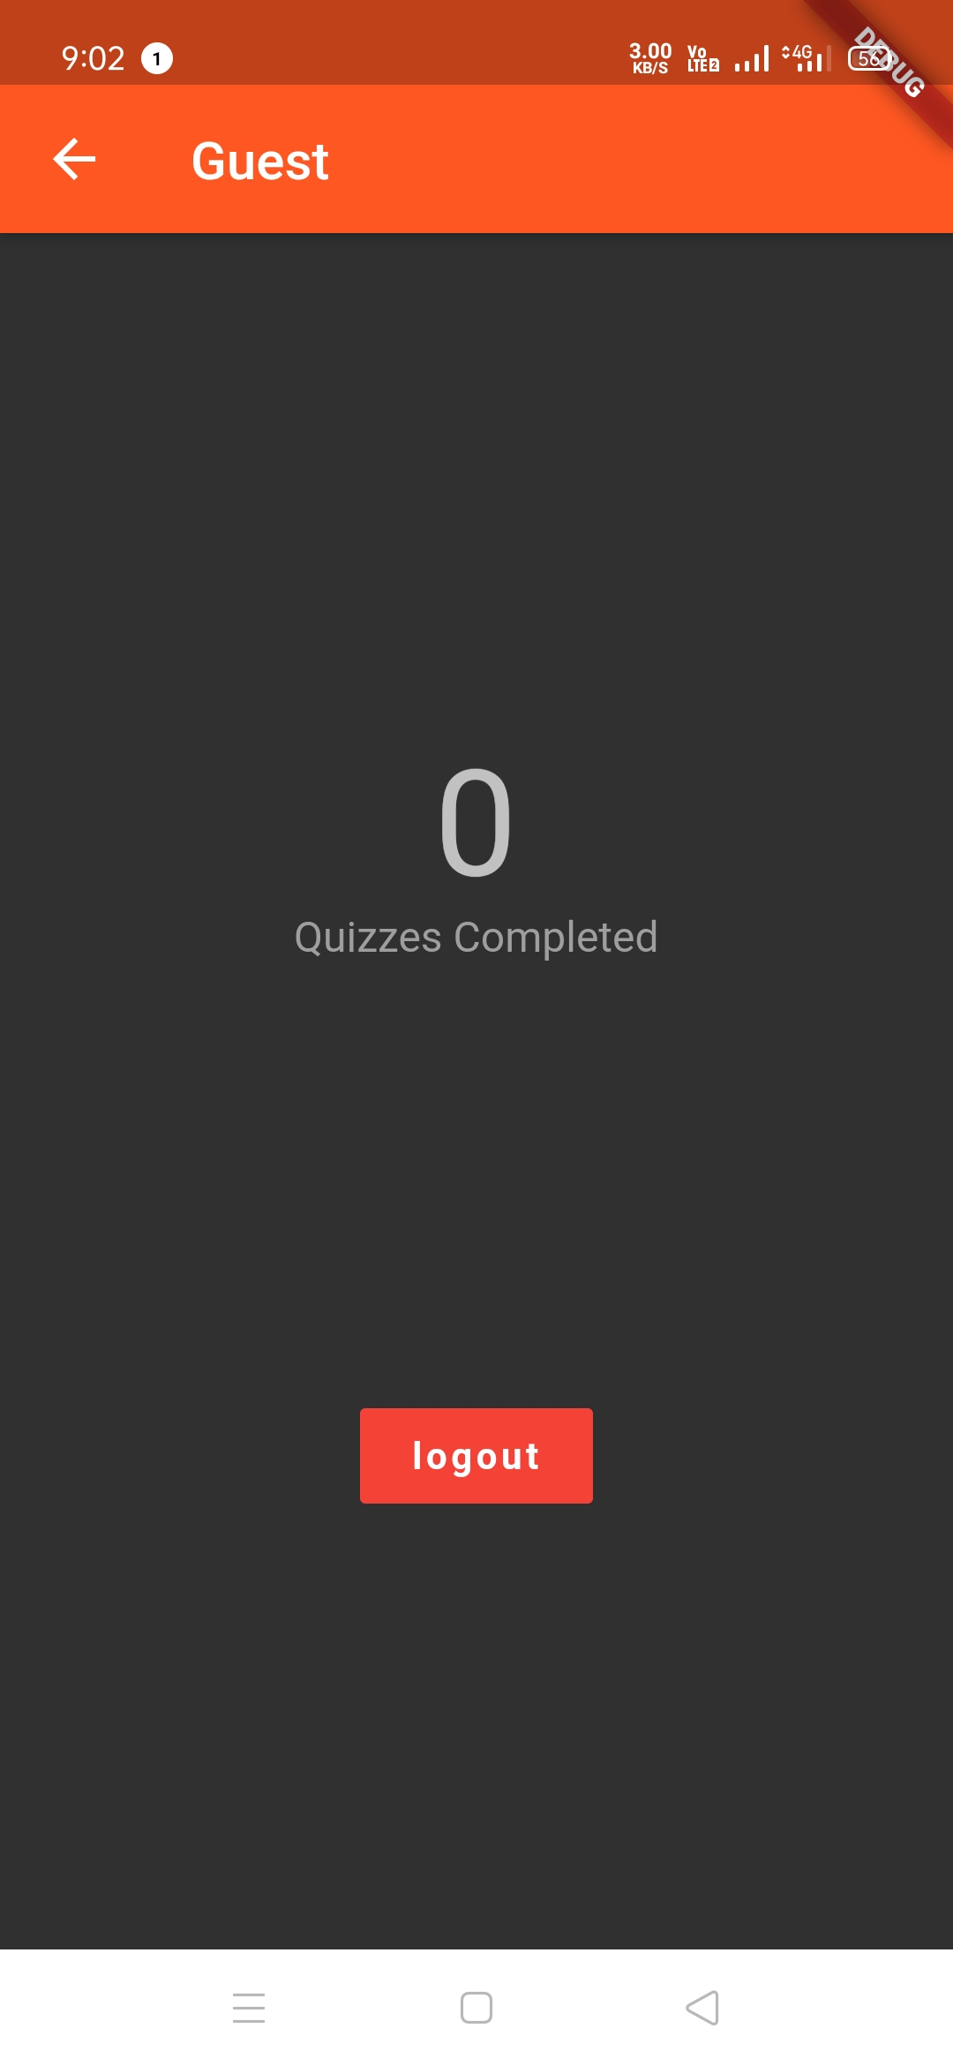
User Interface (cont.)

Slide 7
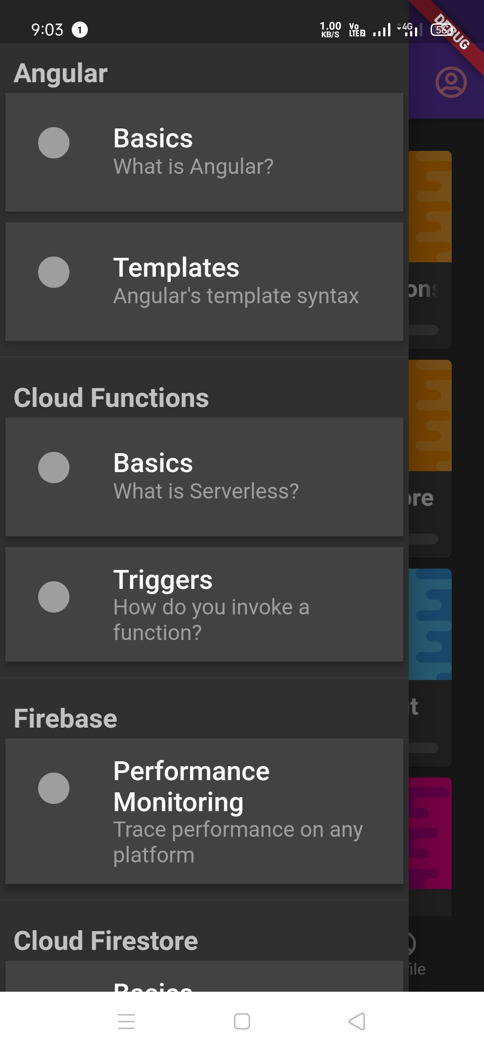
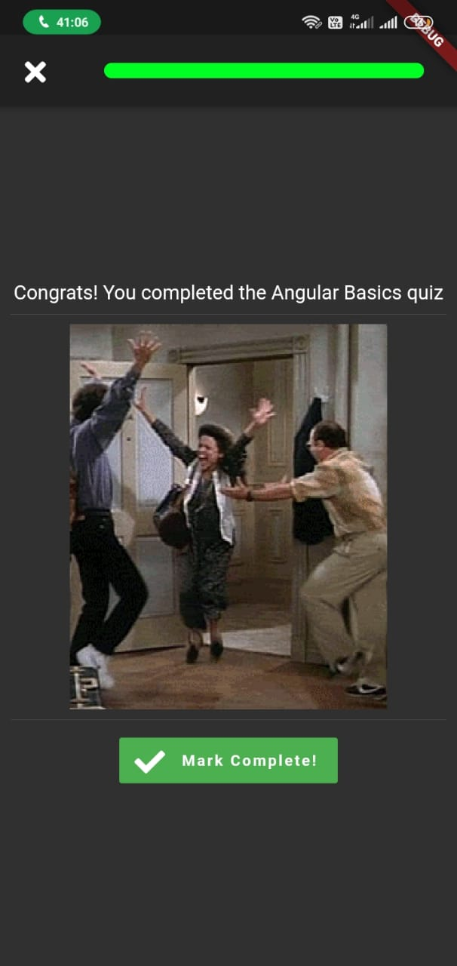
User Interface (cont.)

Slide 8
Thank You

